Slide 1

Alfonso Awadalla, Jade Sillere, Julian Rojas, Maela Guillaume-Le-Gall, Sofia Vaca

Slide 2
Introduction
Challenge Green Data for Health
Mission: To build a tool for observing and analysing the various determinants of health and environment at a local level
Aims of the tool:
Gather data on a single platform and make it easier to consult and enrich territorial diagnostic.
Provide planning stakeholders, technicians and elected representatives with information on health and the environment in their areas.
Steps:
1) Construction of relevant health and environment indicators
2) Visualisation on an interactive map

Slide 3
Déterminant - Qualité de l’air

Slide 4

Indicateur: nombre moyen de jours supérieur ou égal à mauvais pour la qualité de l’air
Source of the BDD:
Raw daily pollution data on PM2.5, PM10, NO2, SO2 and O3 from every station in every region from Geod’air from 1/1/23 - 31/12/23 (inclusive).
Resolution of the data: Station-level
Difference from Cahier des Charges index:
Index using recreated ATMO index due to lack of a login for ATMO France data
Using proportion of days of a year instead of count

Slide 5
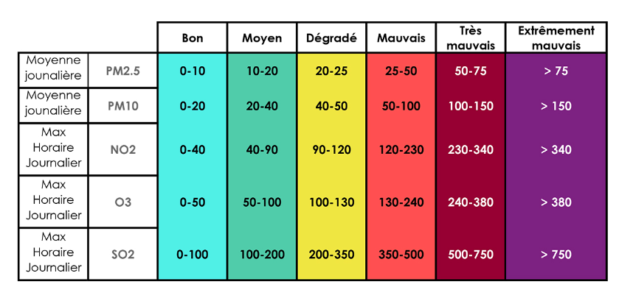
Indicateur: nombre moyen de jours supérieur ou égal à mauvais pour la qualité de l’air
ATMO Sub-score
1 2 3 4 5 6
Methodology followed:
Recreated ATMO index using their methodology
Took the percentage of days over the year available which have an ATMO score greater than or equal to 3 out of the total number of days available.
Source: ATMO France
Notes:
ATMO methodology:
Each range of each of the 5 pollutants is assigned an ATMO sub-score of 1-6 (from best-to-worst) and the daily ATMO index score is the maximum ATMO daily sub-score of the 5 pollutants.

Slide 6
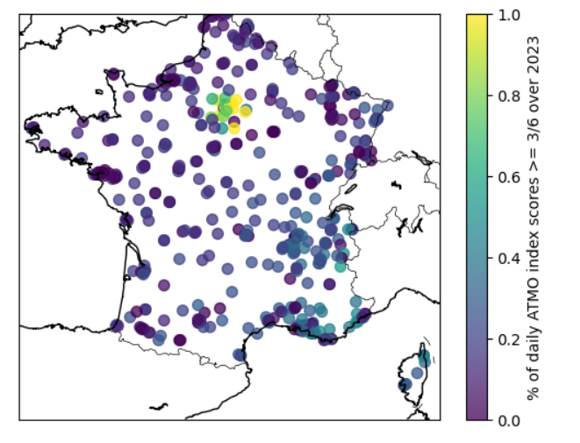
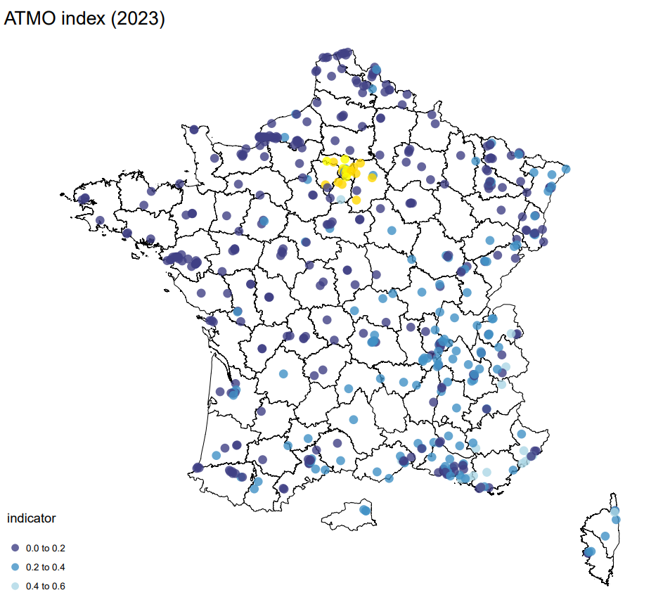
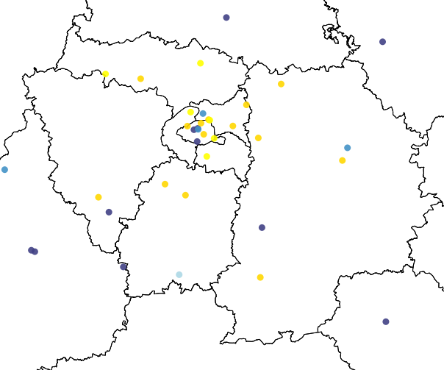
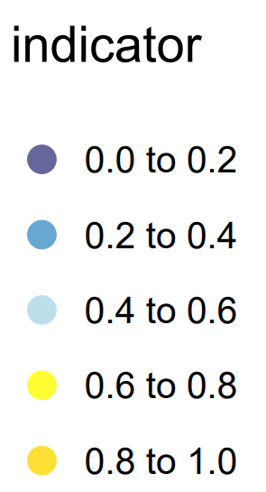
Indicateur: nombre moyen de jours supérieur ou égal à mauvais pour la qualité de l’air
Indicator at highest resolution (station-level)
Focus on area with highest coverage (station-level)
*
Focus: Ile-de-France
Next steps :
To calculate a radius using the relevant wind travel formulas (i.e., areas from which wind moved into the detection area of the station during measuring time) to move up in resolution from station-level to IRIS, Commune, Région and Département
* Proportion of days available in 2023 with an ATMO score of at least 3/6

Slide 7
Indicateur: SOMO35
Source of the BDD:
Raw daily pollution data on O3 from every station in every region from Geod’air from 1/1/23 - 31/12/23 (inclusive).
Resolution of the data: Station-level
Difference from Cahier des Charges index:
Index recreated due to lack of a login for ATMO France data
Notes:
Incomplete yearly coverage example: O3 data does not cover the whole year for all sites in Auvergne-Rhône-Alpes (Les ménuires site data coverage for 2023 begins from 04/01/23 and the Valence Urb. Centre site data coverage for 2023 begins from 2023/07/12).

Slide 8
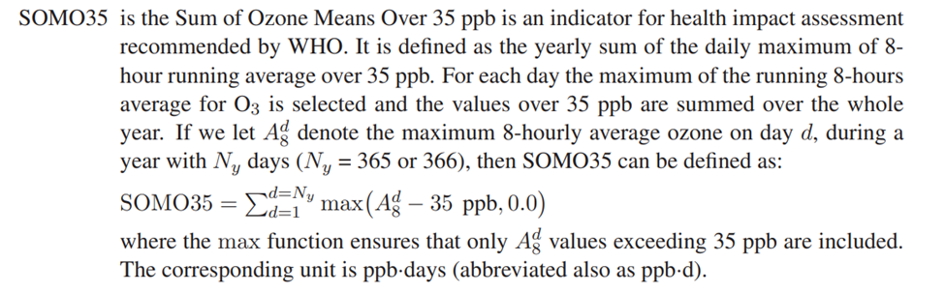
Indicateur: SOMO35
Methodology followed:
Recreated the SOMO35 indicator following the methodology:
For each daily max hourly Ozone data point:
if the maximum exceeds 70 µg/m3 (35 ppb) then the daily score is the difference
Otherwise, it is 0
Summing over the daily scores for the year.
Source: European Monitoring and Evaluation Programme

Slide 9
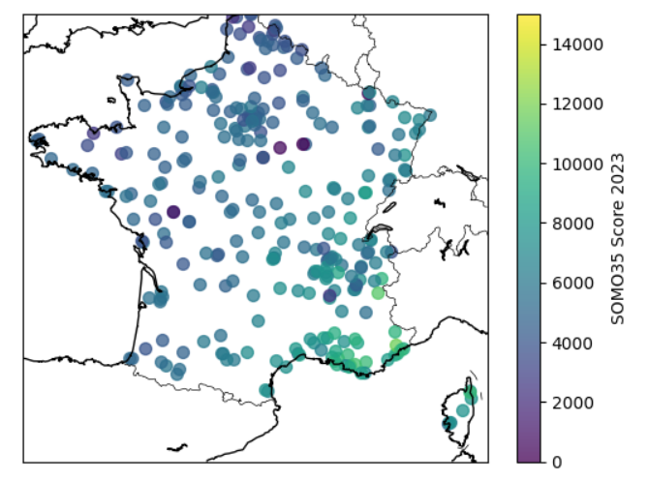
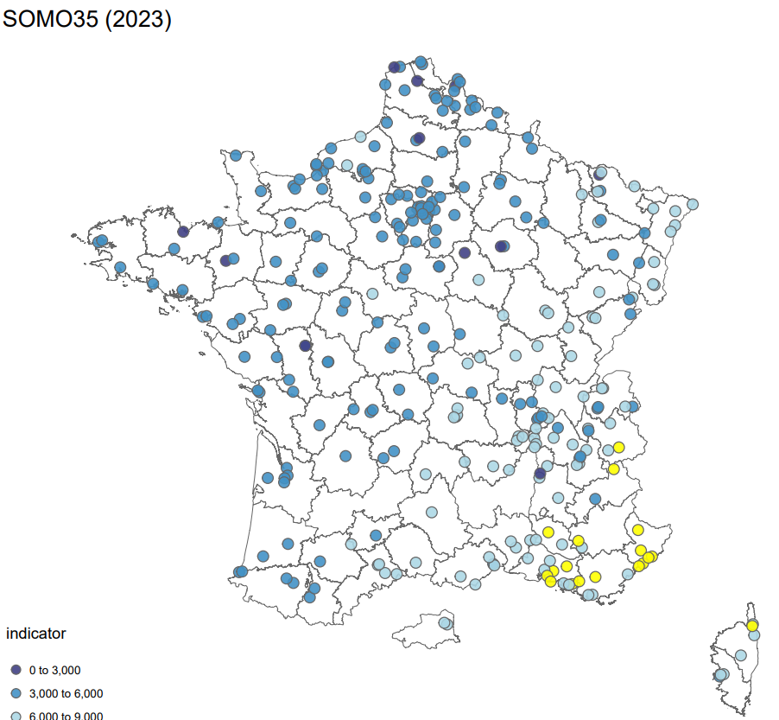
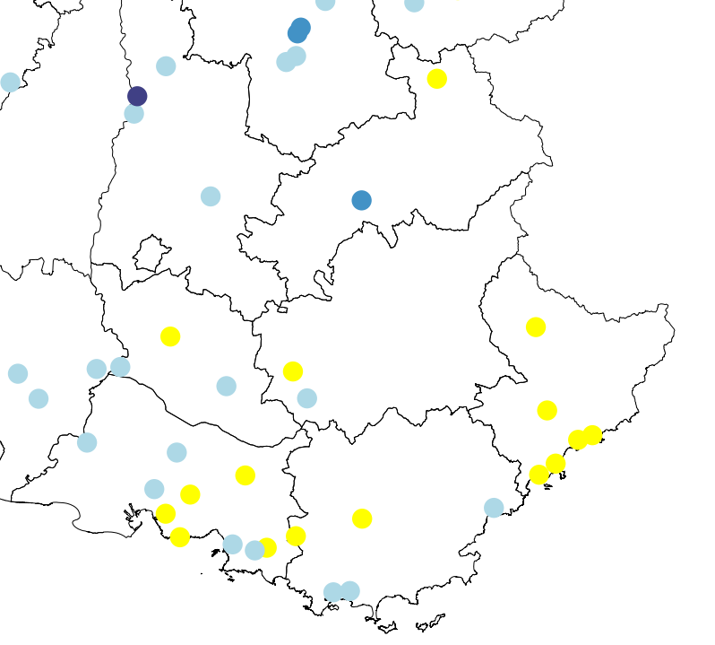
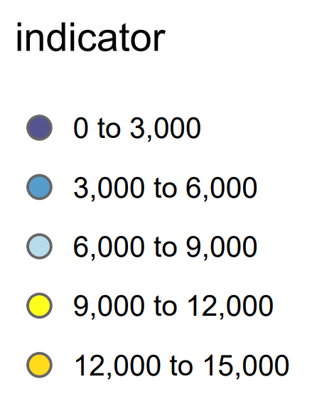
Indicateur: SOMO35
Indicator at highest resolution (station-level)
Indicator with focus on area with highest coverage (station-level)
*
Focus: Provence-Alpes-Côte d'Azur
Next steps :
To calculate a radius using the relevant wind travel formulas (i.e., areas from which wind moved into the detection area of the station during measuring time) to move up in resolution from station-level to IRIS, Commune, Région and Département
* SOMO35 Score

Slide 10


Déterminant - Gestion des eaux

Slide 11
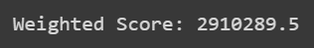
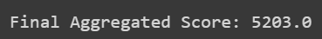
Indicateur: Indicateur qualité des eaux souterraines
Score corresponding to the sum of weighted sites.
Weighting is defined based on the type and status of the site to attempt to account for the variation in nature and magnitude of pressures and impacts. Weighting is also adjusted to consider the proximity of populations to the sites (INERIS, page 28).
Two databases were used:
BASOL.json (base de sites et sols pollués)
icpe.geojson (Geographic file for the location of classified installations)
Data extracted in January 2020
Steps for Weighting
Step 1: Calculate the weights by the condition site
Step 2: Weight of the site condition 'Absence de surveillance justifiée': 1 'Surveillance différée en raison de procédure en cours': 0.5
Step 3: Weighting the adjusted score to proximity of population sites
'0 - 250 meters' : 1,
'250 - 500 meters' : 0.5
'500 - onwards' : 0.2

Slide 12
Indicateur: Indicateur sécheresse
By geographical area, weight the risk of a territory to face drought episodes according to the number of days the territory is under alert, reinforced alert, or crisis.
Data used:
zones_arretes_en_vigueur.geojson
all_zones.shp

Slide 13
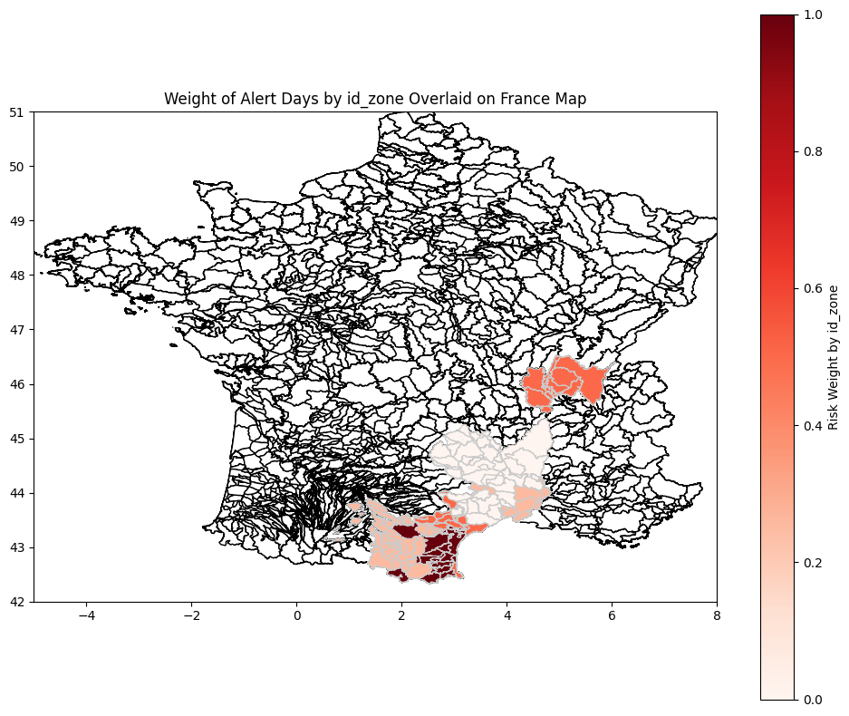
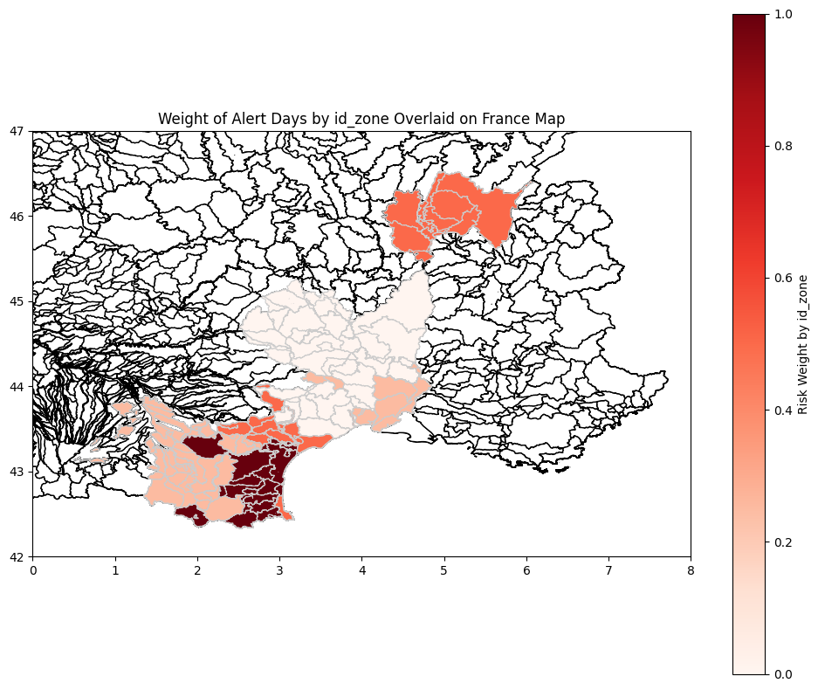
Indicateur: Indicateur sécheresse
Zones/Departments
Lozère, Ain, Gard, Aude, Hérault, Pyrénées-Orientales
Drought risk by geographical area: Alerte (0), Vigilance (0.25), Alerte renforcée (0.5), Crisis (1)

Slide 14
Déterminant - Biodiversité

Slide 15
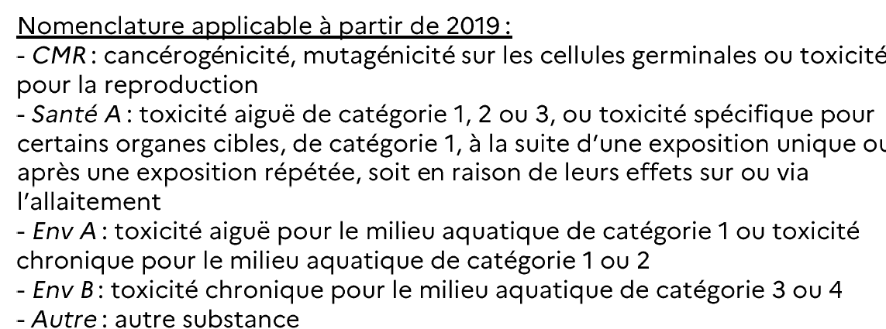
Indicateur: Quantités de pesticides achetés par commune
Methodology:
Information by postal code
Weights on the communes that share the same postal codes
Indicator:
Total quantity of substance in kilograms bought by commune according to the categories that group the substances.

Slide 16
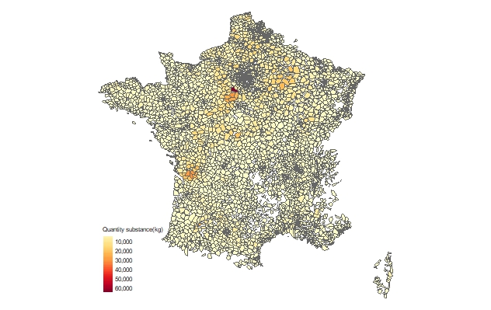
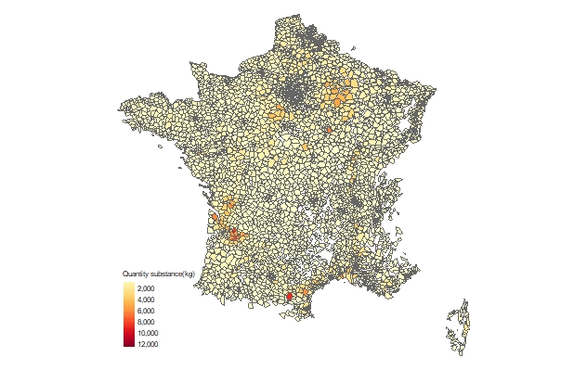
Indicateur: Quantités de pesticides achetés (kg)
CMR:
Santé A:

Slide 17
Déterminant - Temperature

Slide 18

Indicateur: Taux de couvert forestier
Source :
Data in the form of 84 different GeoTiff files covering France
Methodology :
Extract value and coordinate from each pixel of every geospatial data and merge all the points
Downloaded shapefiles from INSEE for each scale → fill those pixels in each polygons and take the mean value
Description of the indicator:
Density of tree cover across the country
Data ranges from 0% to 100% → areas with no tree cover up to those completely covered by trees
Based on 2018 data

Slide 19
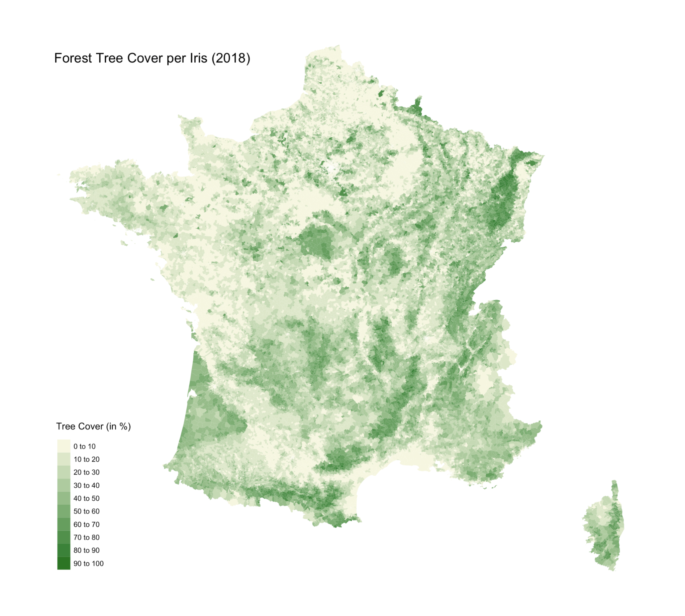
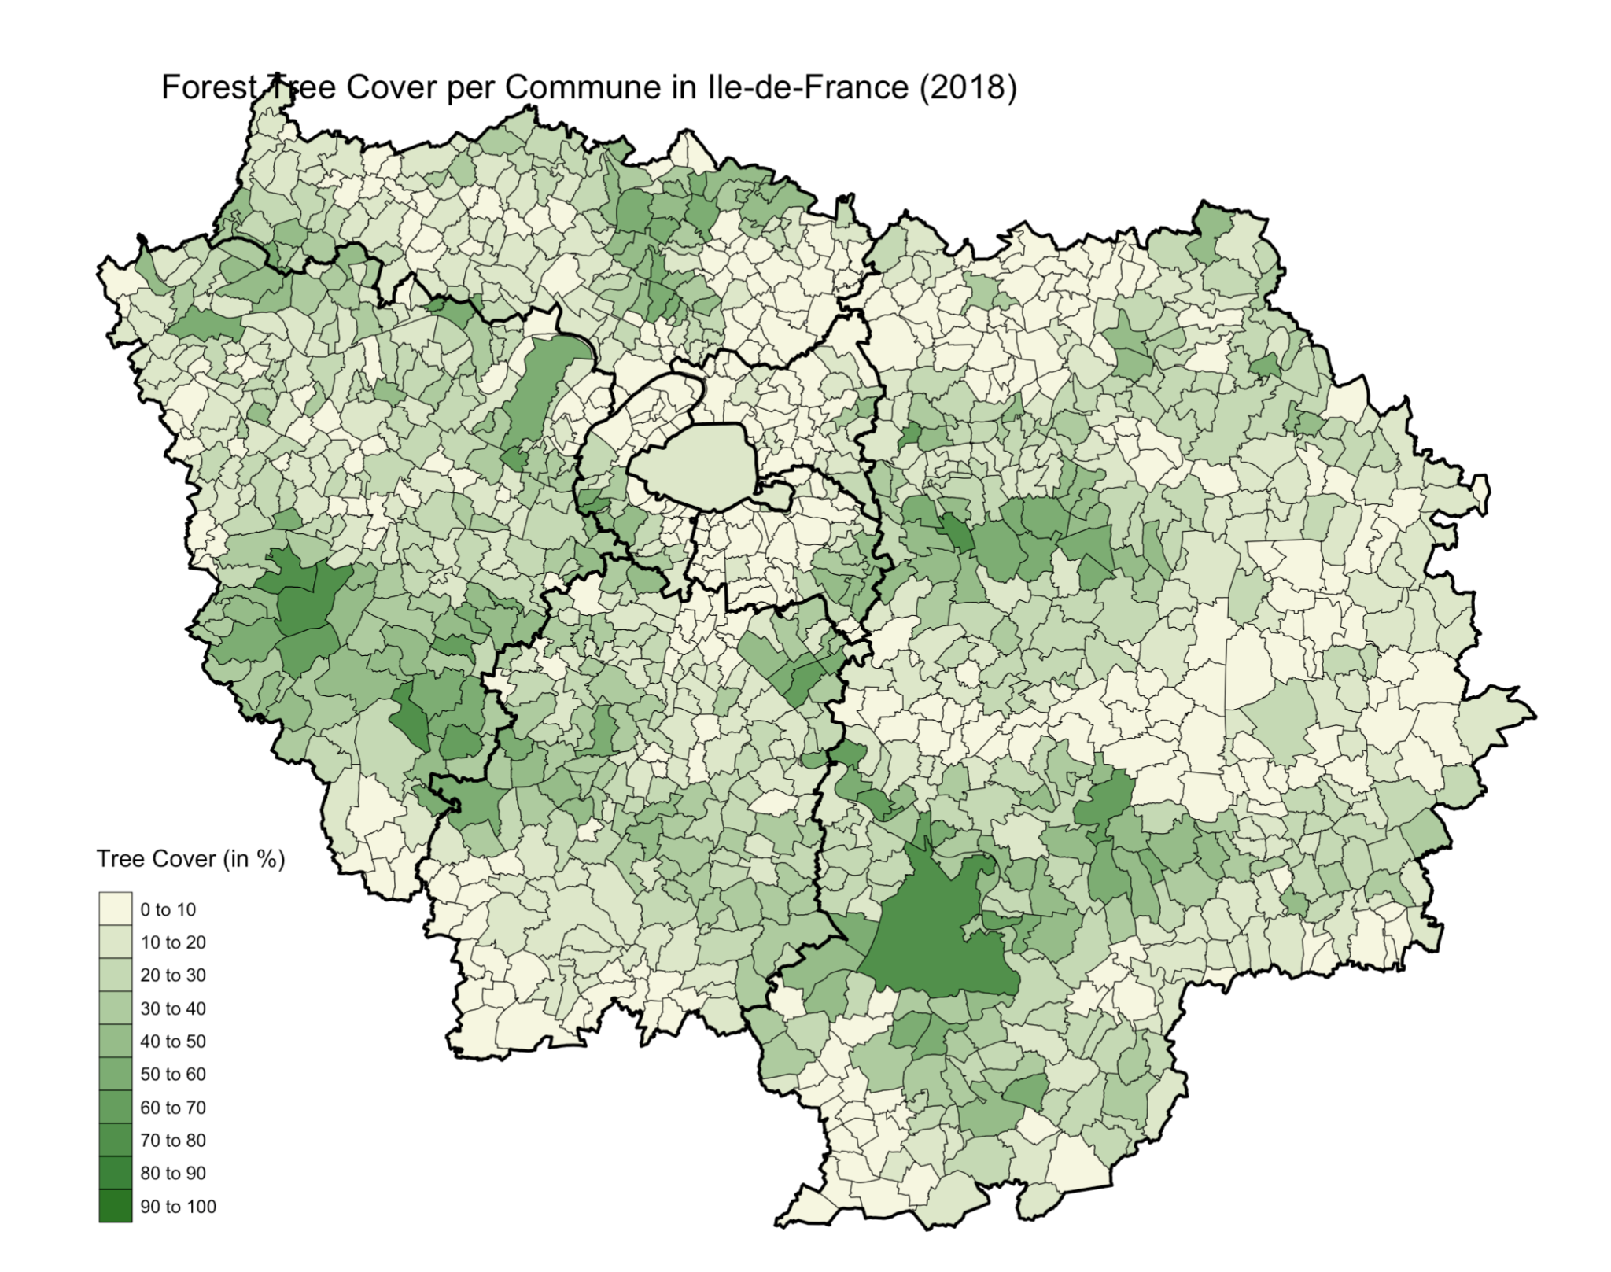

Slide 20
Indicateur: Taux de surface imperméabilisée
Source:
Data in the form of 84 different GeoTiff files covering France
Methodology followed:
Extract value and coordinate from each pixel of every geospatial data and merge all the points
Downloaded shapefiles from INSEE for each scale → fill those pixels in each polygons and take the mean value
Description of the indicator:
Imperviousness Density across the country
Range from 0% to 100%
Based on 2018 data

Slide 21
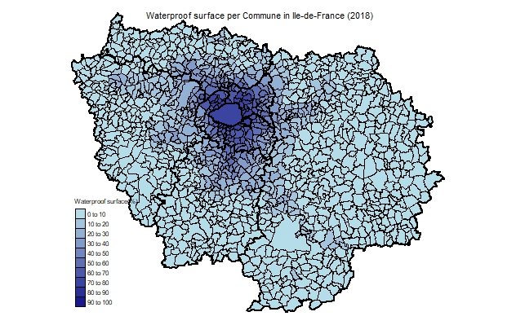
Indicateur: Taux de surface imperméabilisée
Ile de France:

Slide 22
Déterminant - Pollution lumineuse/luminosité

Slide 23
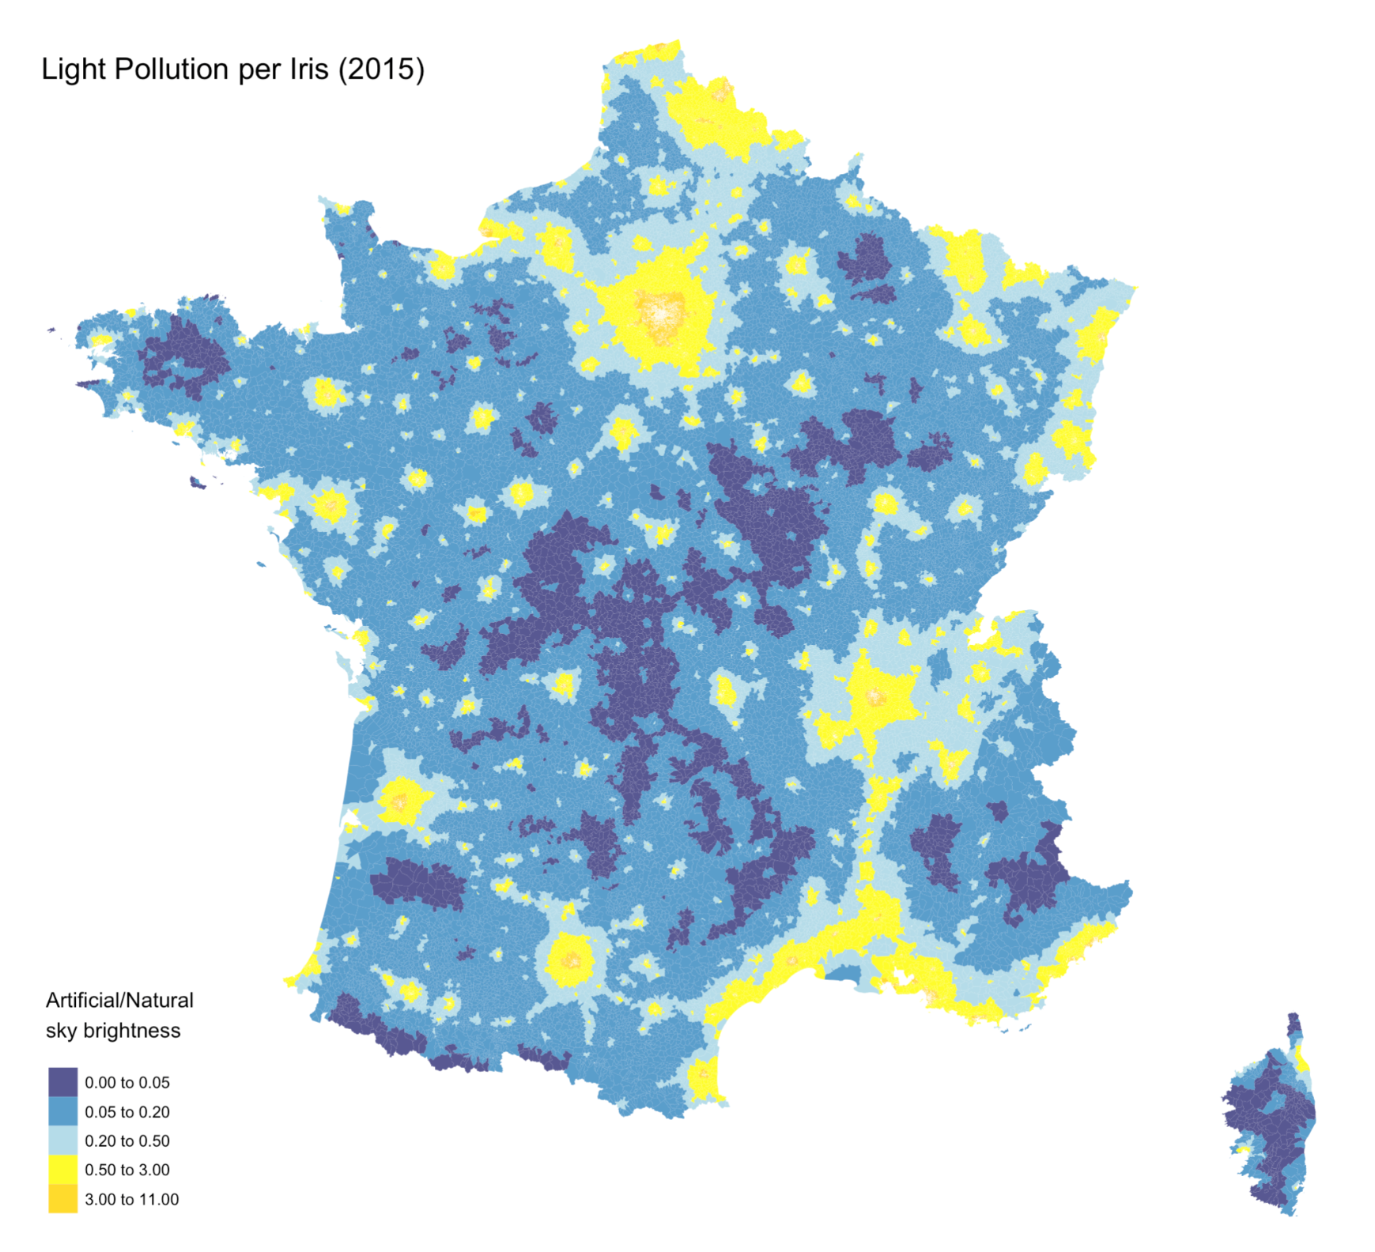


Indicateur: Radiance
Source :
Data in the form 1 GeoTiff file covering the world
Methodology :
Crop the World Tiff file to France by using a France shapefile from the EU Environment Agency
Extract value and coordinate from each pixel
Downloaded shapefiles from INSEE for each scale → fill those pixels in each polygons and take the mean value

Slide 24
Indicateur: Radiance
Description of the indicator:
Artificial night sky brightness [microcandelas per square meter (mcd/m^2)]
Ratio of artificial to natural sky brightness, focusing solely on artificial lighting
Ratios range 0 to 11 → areas with no light pollution to those with pollution 11 times above natural levels
Based on 2015 data

Slide 25
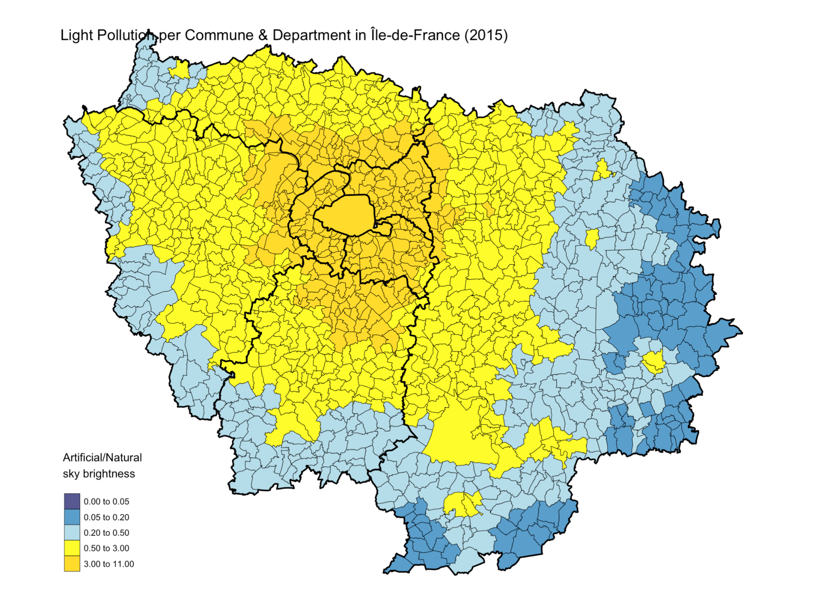

Slide 26
Determinant - Physical and sports activities

Slide 27
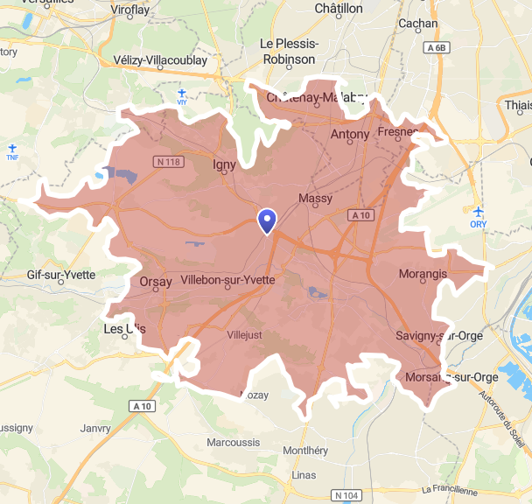
Indicateur: Nombre d’infrastructures sportives accessibles à 15 minutes en voiture
First step : Create isochrones
Calculate commune centroids
Calculate the area within a 15-minute drive from the centroid
Using Open Source Routing Machine (OSMR) :
data of the OpenStreetMap, calculate real travel time by road
(by car, off-peak)
Example : Palaiseau isochrone, 15 minutes by car

Slide 28
Indicateur: Nombre d’infrastructures sportives accessibles à 15 minutes en voiture
Second step: Calculate the number of sports facilities located within the isochrone
Data: GPS coordinates of all sports facilities → 1 point = 1 facility
Source : Recensement des équipements sportifs, espaces et sites de pratiques. Ministère des Sports.
Spatial junction between isochrones and sports data
Sum the number of infrastructure present in the isochrone
=> results by commune, cut into deciles for visualization

Slide 29
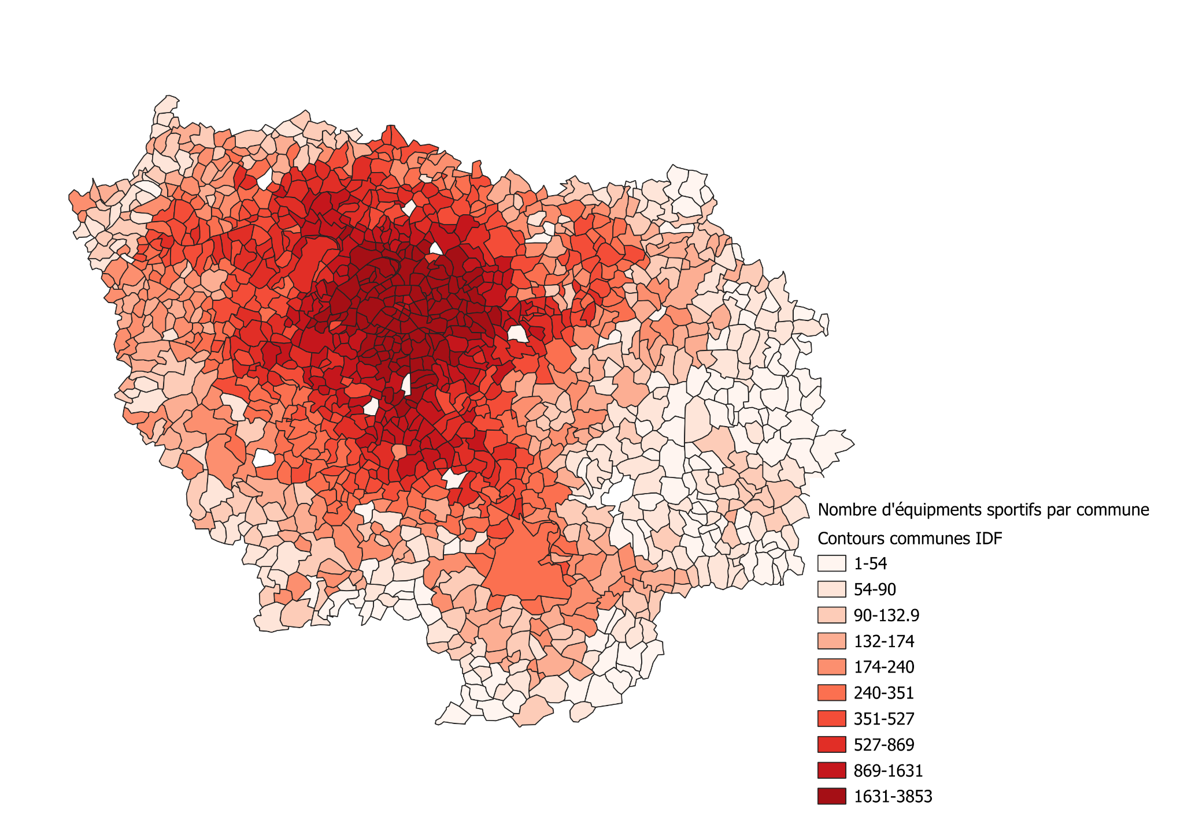
Indicateur: Nombre d’infrastructures sportives accessibles à 15 minutes en voiture
Région Ile-de-France
Number of sports facilities per commune,
Cut into deciles

Slide 30
Determinant - Access to jobs, services and facilities

Slide 31
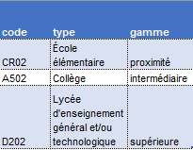
Indicateur: Taux de services de proximité accessibles à 6 min. en voiture
1st step : Create isochrones
2nd step : Calculate inside service rates
Data : GPS coordinates of all services
→ 1 point = 1 equipment
Data source : Base permanente des équipements, INSEE
Use a linking table to select only “services de proximité” (24 types)
Spatial junction between isochrones and proximity services
Calculate the percentage of proximity services actually present in the isochrone
Passage table - BPE

Slide 32
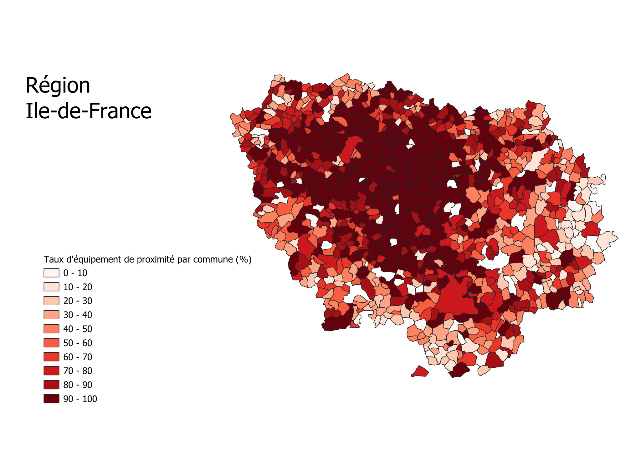
Indicateur: Taux de services de proximité accessibles à 6 min. en voiture

Slide 33
Visualisation Tool

Slide 34
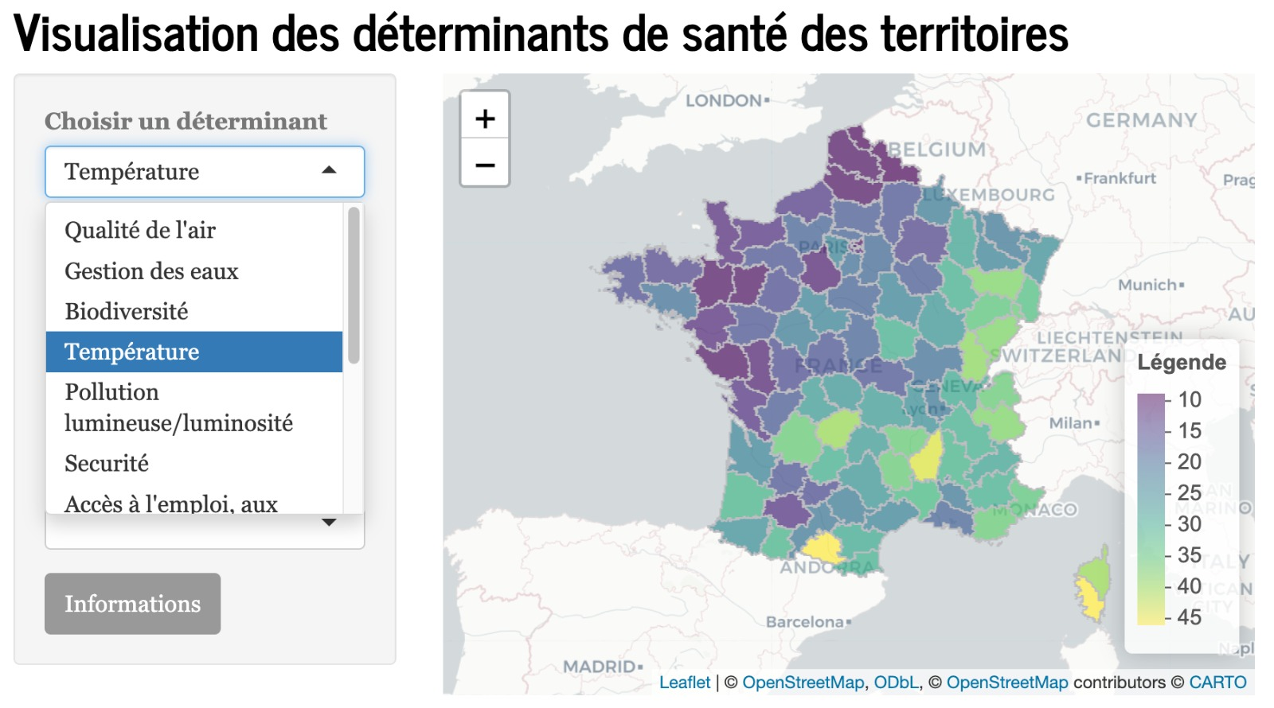

Slide 35
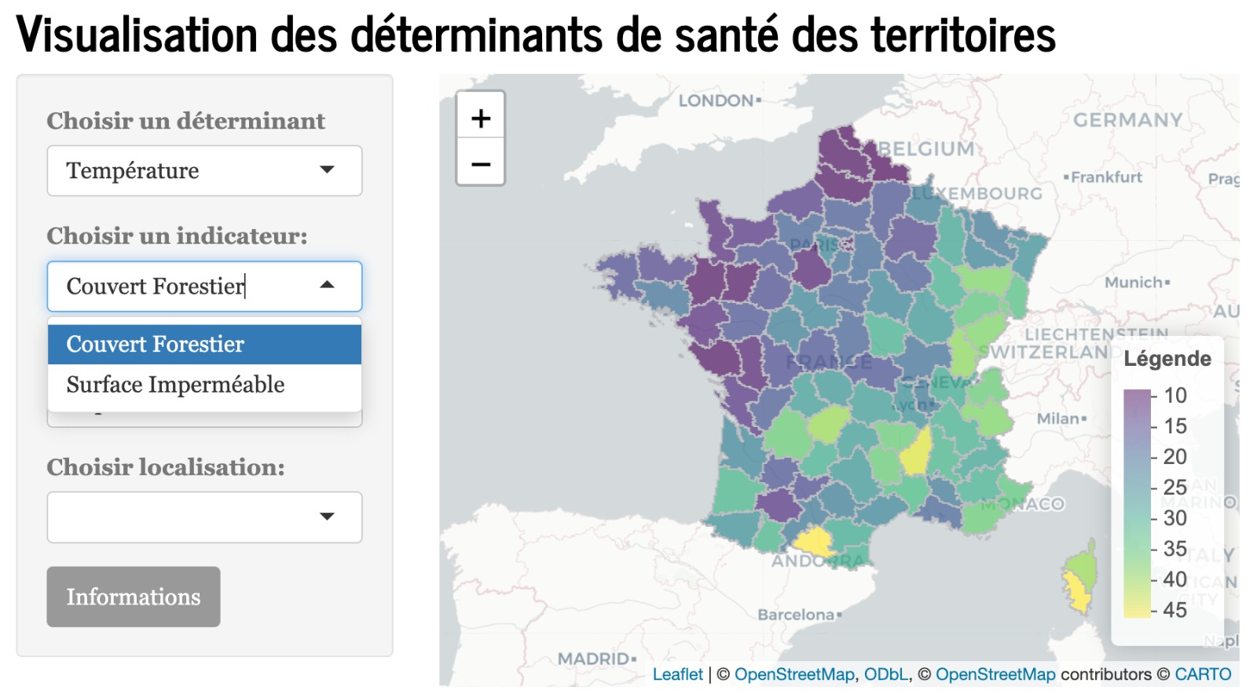

Slide 36
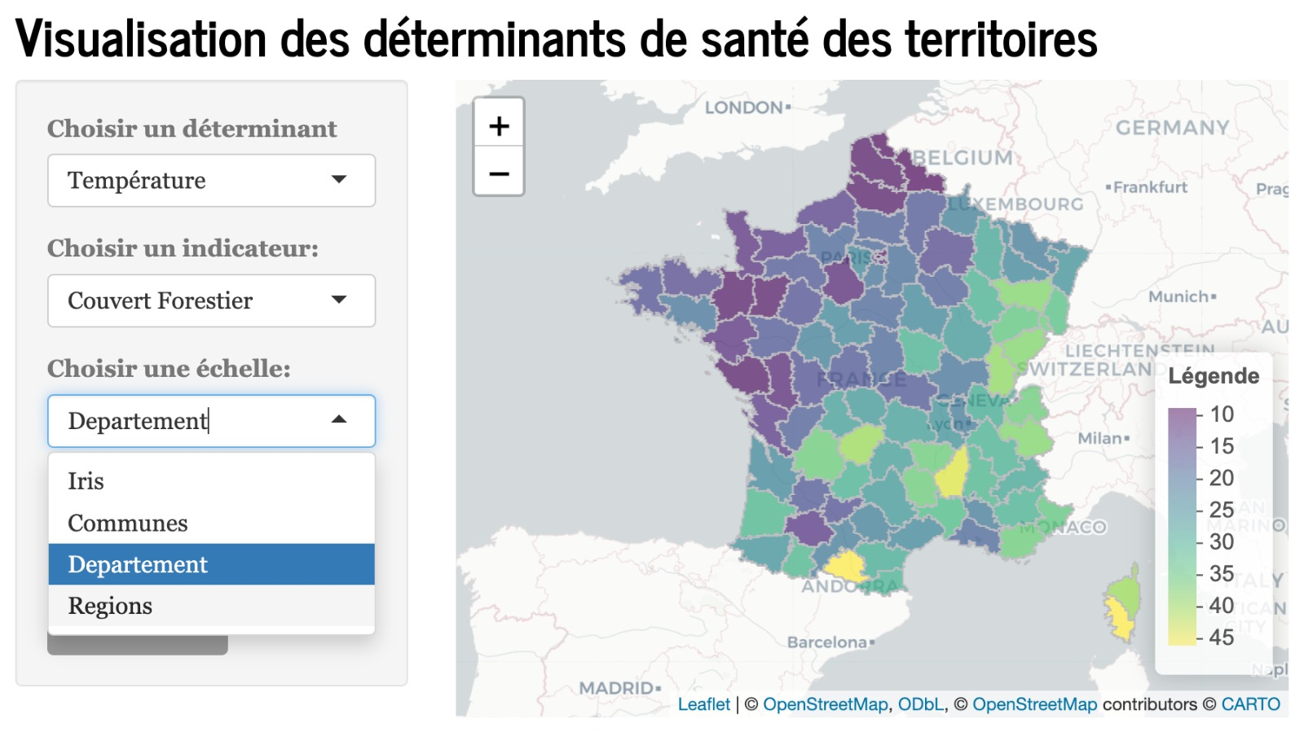

Slide 37
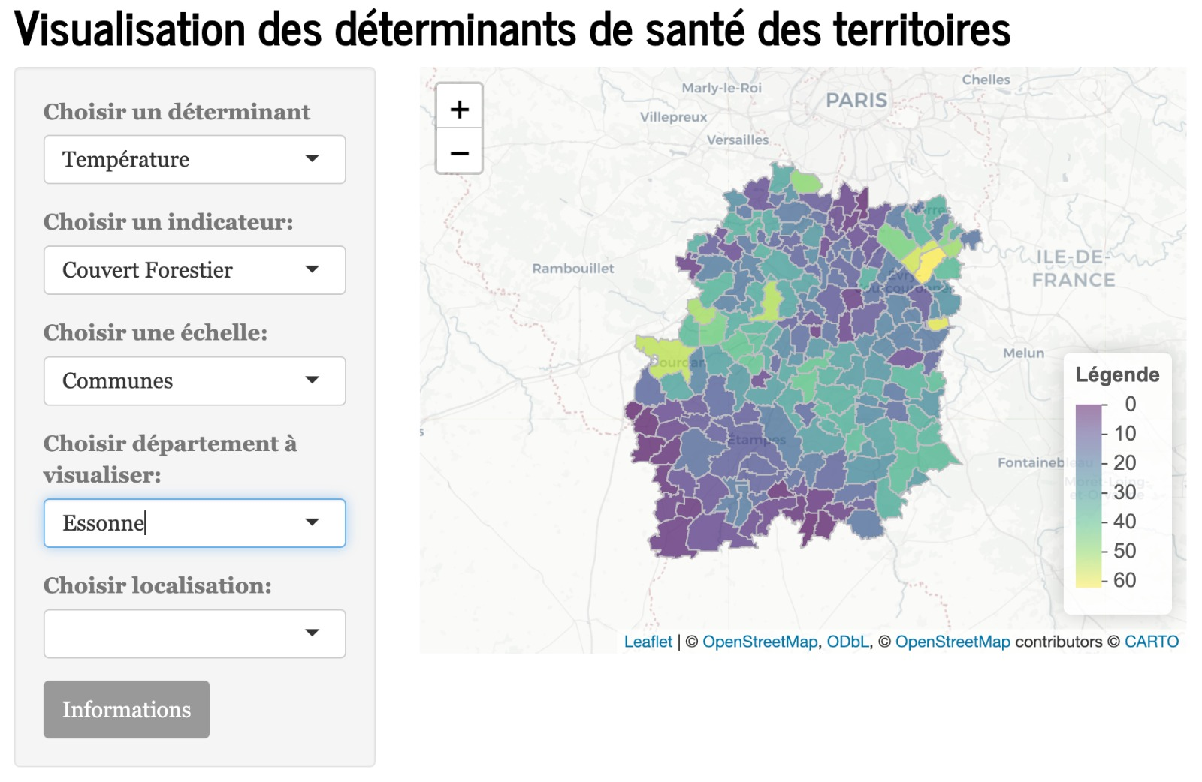

Slide 38
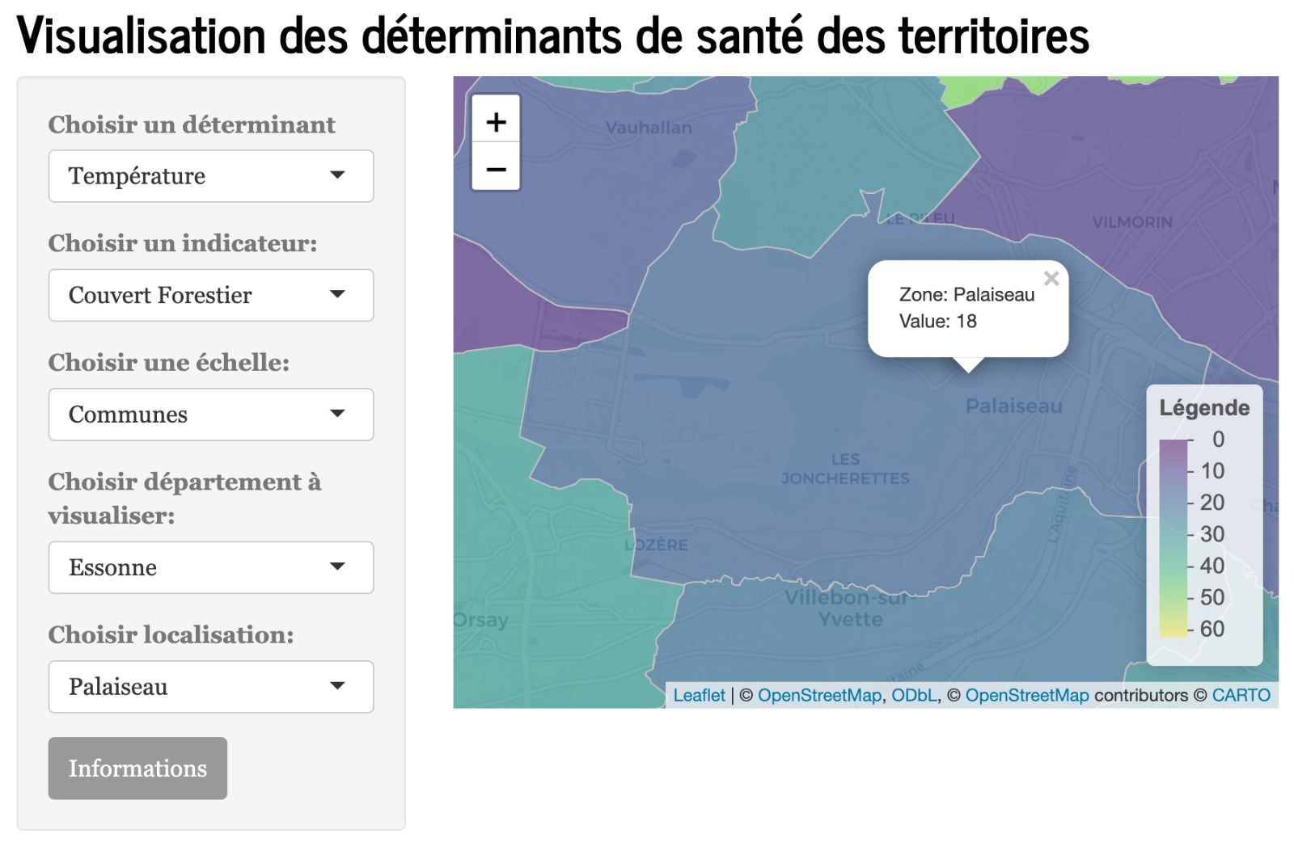

Slide 39
